Slide 1
Microservices and DevOps
Scalable Microservices
Messaging
Henrik Bærbak Christensen

Slide 2
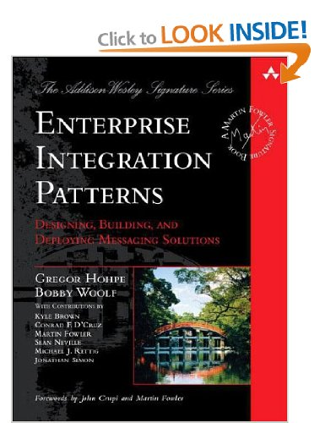
Literature
Hohpe & Woolf, 2004
  We will just scratch the surface

Slide 3
Example
Messaging in One Minute

Slide 4
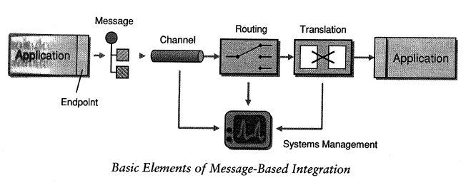
Reference Architecture
Any Messaging system will have this architecture
Metaphor of Messaging: Mail and mailboxes
  Message = a letter
  Channel = mailbox
  Routing = address, stating who to receive
Is Asynchronous !

Slide 5
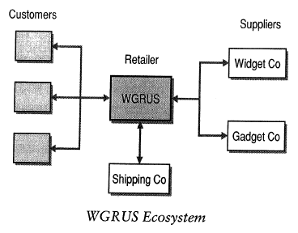
Example: WGRUS
Retailer selling widgets and gadgets
  Orders by web, by phone, by fax
  Processing
    Check inventory, shipping, invoicing
  Status check by customer
  Admin
    Update prices
    Update user details

Slide 6
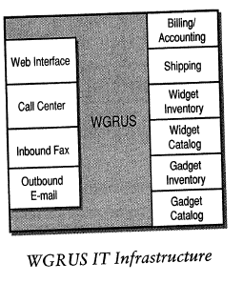
Legacy Systems
WGRUS is a merged company
How do we bind all these systems together?

Slide 7
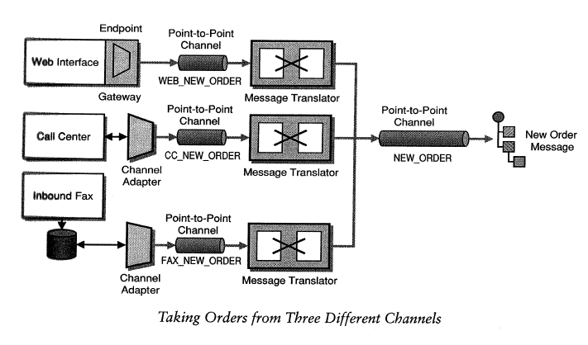
Client side
A MQ based solution
  How to make ‘a order’ a uniform message from three different systems and processes

Slide 8
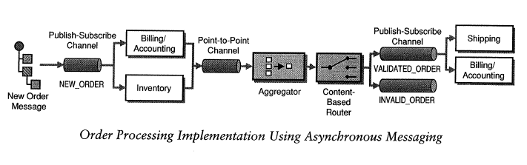
Server side
How do we handle that an order must
  Update and verify inventory status
  Be packed and shipped
  Invoiced
  Or perhaps rejected?

Slide 9
Discussion
Enterprise Service Bus
  The solution to all integration issue?
AntiPattern: Swiss Army Knife
  Is it super smart? Or one tool that does all jobs equally poor?
Jim Webber (REST guru)
  ESB becomes one big ball of mud

Slide 10
Patterns
Just the simple ones...

Slide 11
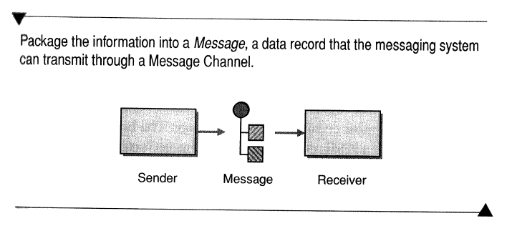
Message

Slide 12
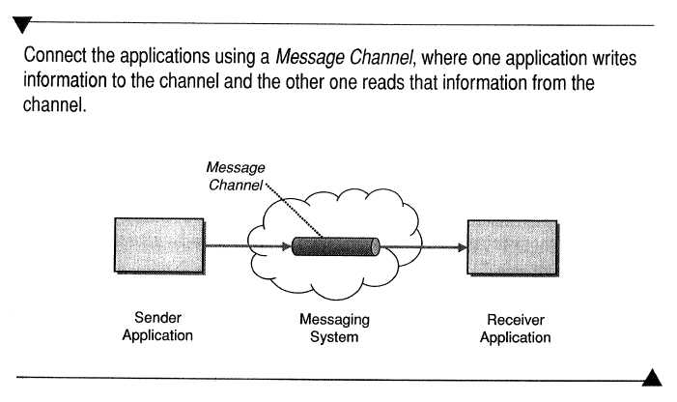
Message Channel

Slide 13
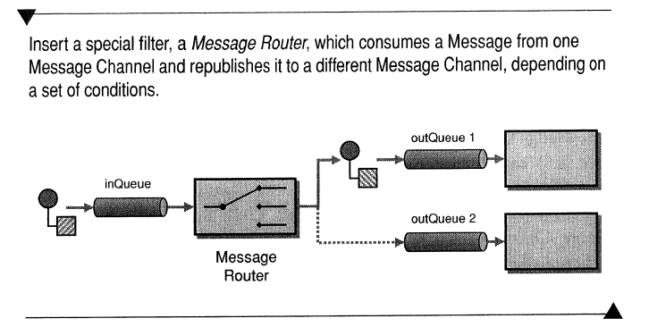
Message Router

Slide 14
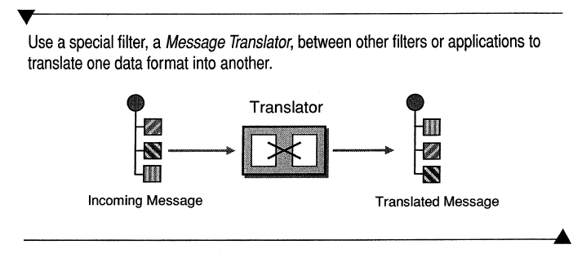
Message Translator

Slide 15
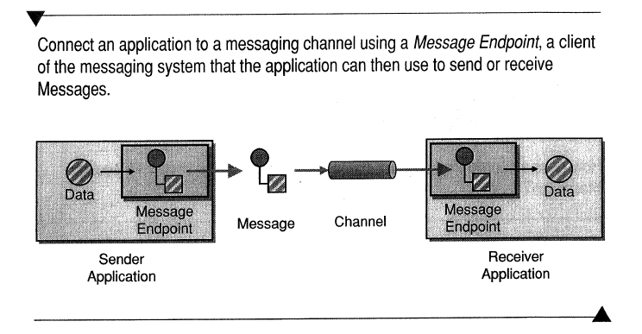
Message Endpoint

Slide 16
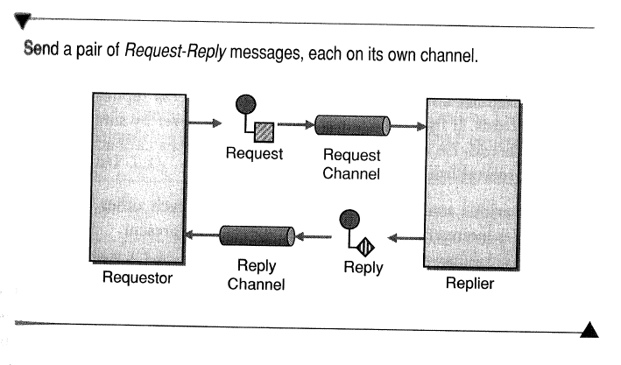
Request-Reply

Slide 17
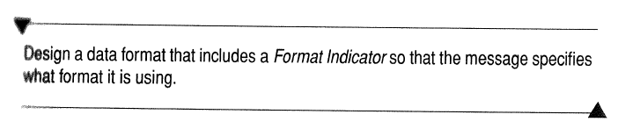
Format Indicator

Slide 18
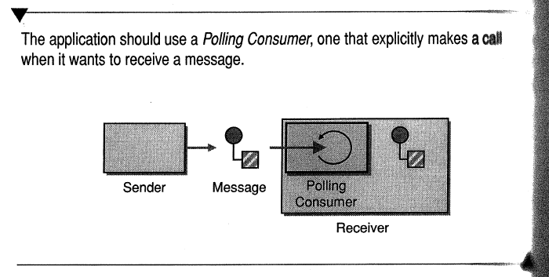
Polling Consumer

Slide 19

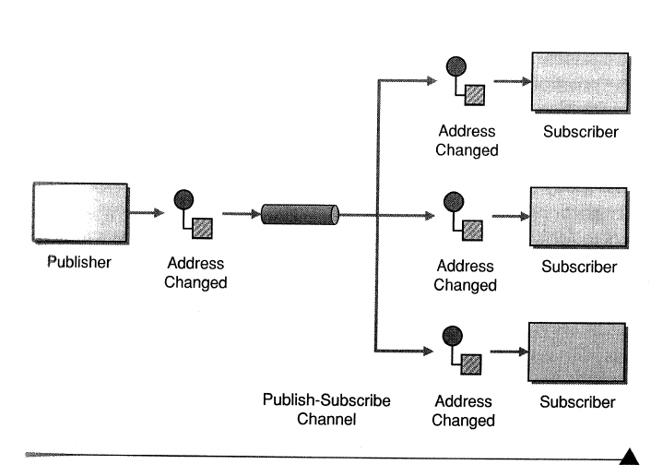
Publish-Subscribe Channel

Slide 20
RabbitMQ

Slide 21
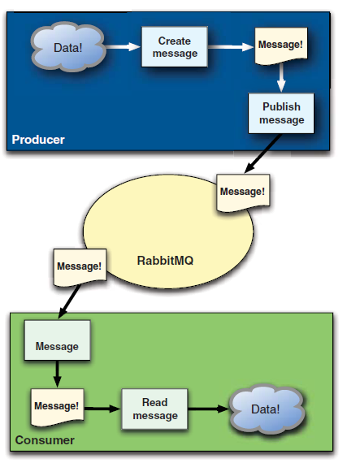
The Basic Architecture

Slide 22
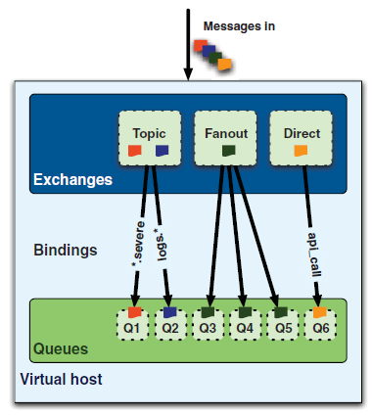
Exchanges and Queues
Clients push messages to exchanges
Serves pulls messages from queues
Bindings govern how exchanges moves messages to queues

Slide 23
Direct
Direct is ‘point-to-point’ communication ala Broker/REST
  Essentially it seems there is no exchange, because our message ends up on the queue right away

Slide 24
Fanout
Publish-subscribe uses fanout
  Clients pushes to a named exchange (ex: ”logs”)
  Queues are bound to a named exhange (ex: Q3-logs)
  Server pull from named queue

Slide 25
Topics
Message Router is configured using topics
  Clients push msg with a specific topic to exchange
    Topic = ”grundfos.reading.store”
  Routing key use macthing to bind queue to exchange
    Store_queue: ”*.*.store”
  Any msg with topic that match
  routing key is put into that
  queue
  Server pull from named queue

Slide 26
Lots of Options
RabbitMQ uses round-robin load balancing
  2 servers connect to queue ‘Q’
    Msg1 to server1, msg2 to server2, msg3 to server1, …
Acknowledgement system
  Default off, but server may acknowledge message is processed
    No new message delivered until message has been ack.
Topic based messaging = many options
  Cluster serves queues bound to ‘*.*.AALBORG’
    Exercise: Which Nygard pattern does that implement?
  Bound to ‘*.server7.*’
    Exercise: What session management does that implement?

Slide 27
Discussion

Slide 28
Reliability and Availability?
So – how does messaging help make more reliable and available systems?
?

Slide 29
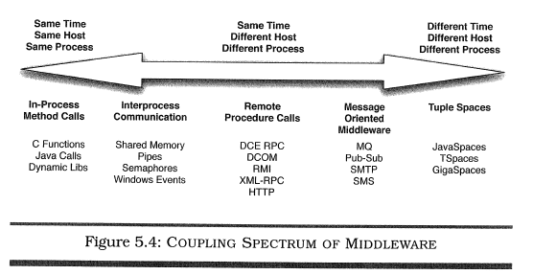
Availability
Different time – Different process
  => Loose coupling at integration points
  Awareness that we are dealing with remote nodes
    Cmp Java RMI, Corba, .NET remoting
      Tries to hide that a call is remote

Slide 30
Availability
Messages are queue in case no consumer
  If the clients do not need an immediate answer...
    Read: data collection systems
  ... Then back-end systems can be maintained while the MQ system just queue up messages for later processing
Message brokers can be clustered
  Replication of queues
Queues can be persisted
  Messages survive crashed nodes/brokers

Slide 31
Availability
Can provide ‘elasticity’ during impulses to counter unbalanced capacities
  During a sudden peak of messages, the MQ serves as a queue, until the consumers can catch up
  Key point: The servers set the pace, not the clients!
Exercise:
  How will the clients experience such a situation?

Slide 32
Liabilities
Instead of
  Client + server as in the REST / Web case
… we have
  Client + message broker + server
Message broker becomes single-point of failure
  Counter measure: Clustering
    But clustering works less well for RabbitMQ (!)
Message broker becomes bottle-neck
  Kafka… Rumors has it that it is extremely fast…
Notes:
Own EcoSense tests: 125Msg/sec of 94KB = 11 MB/sec flooded my daemons, but the MQ worked fine…

Slide 33
Summary
Messaging
  A mail and letterbox metaphor for message exchange
  Allows flexibility in delivery and content change
  Decouples producers and consumers over time
  Asynchronous
RabbitMQ
  Exchanges and Queues are bound at run-time
  Round robin load balancing of queue fetch
Availability and Stability
  Handles impulses well; not strain…

